Slide 1
SOL-GEL METHOD USING ETHANOL

Slide 2
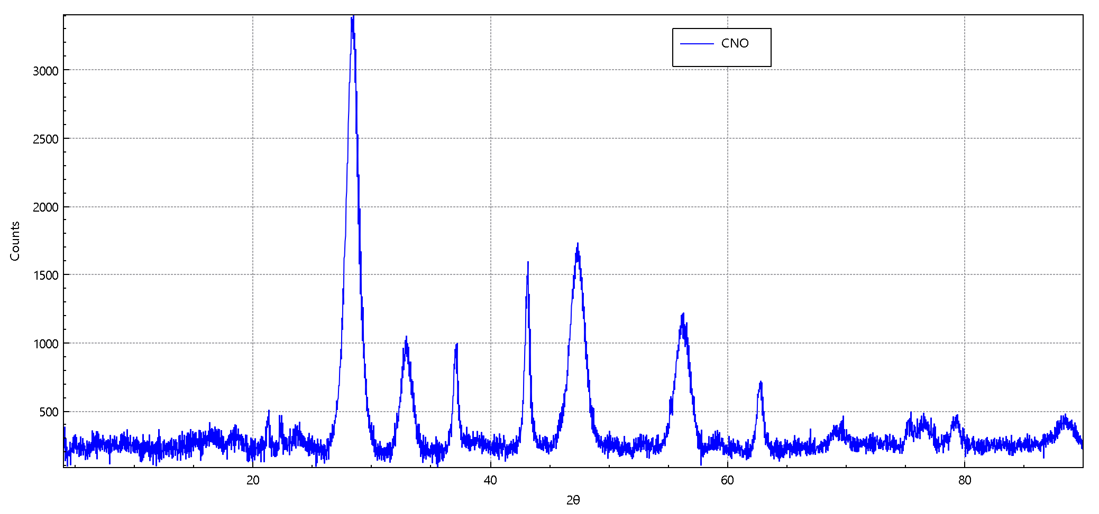
We were forming Ce₂Ni₂0₅ instead we got CeNi_{0.1}0₂ which was annealed for 4 hours at 500⁰C below it is an xrd graph showing single phase peaks

Slide 3
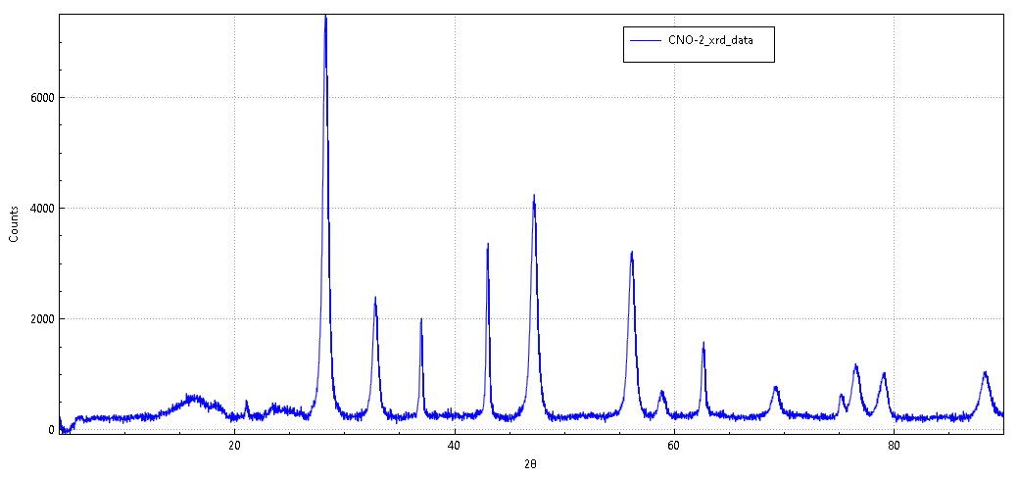
We were forming Ce₂Ni₂0₅ again by changing temperature condition but instead we got CeNi0₃ which was annealed for 8 hours at 700⁰C below it is an xrd graph showing single phase peaks

Slide 4
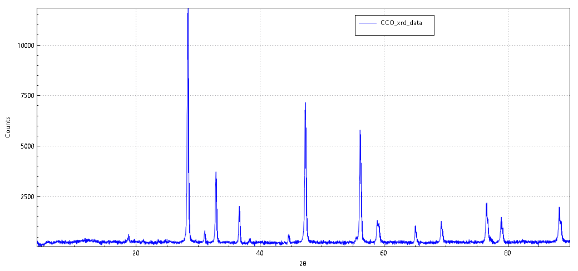
We were forming Ce₂Co₂0₅ and we got CeCo₃0₇ which was annealed for 8 hours at 800⁰C below it is an xrd pattern showing single phase peaks

Slide 5
SOL-GEL METHOD USING CITRIC ACID

Slide 6
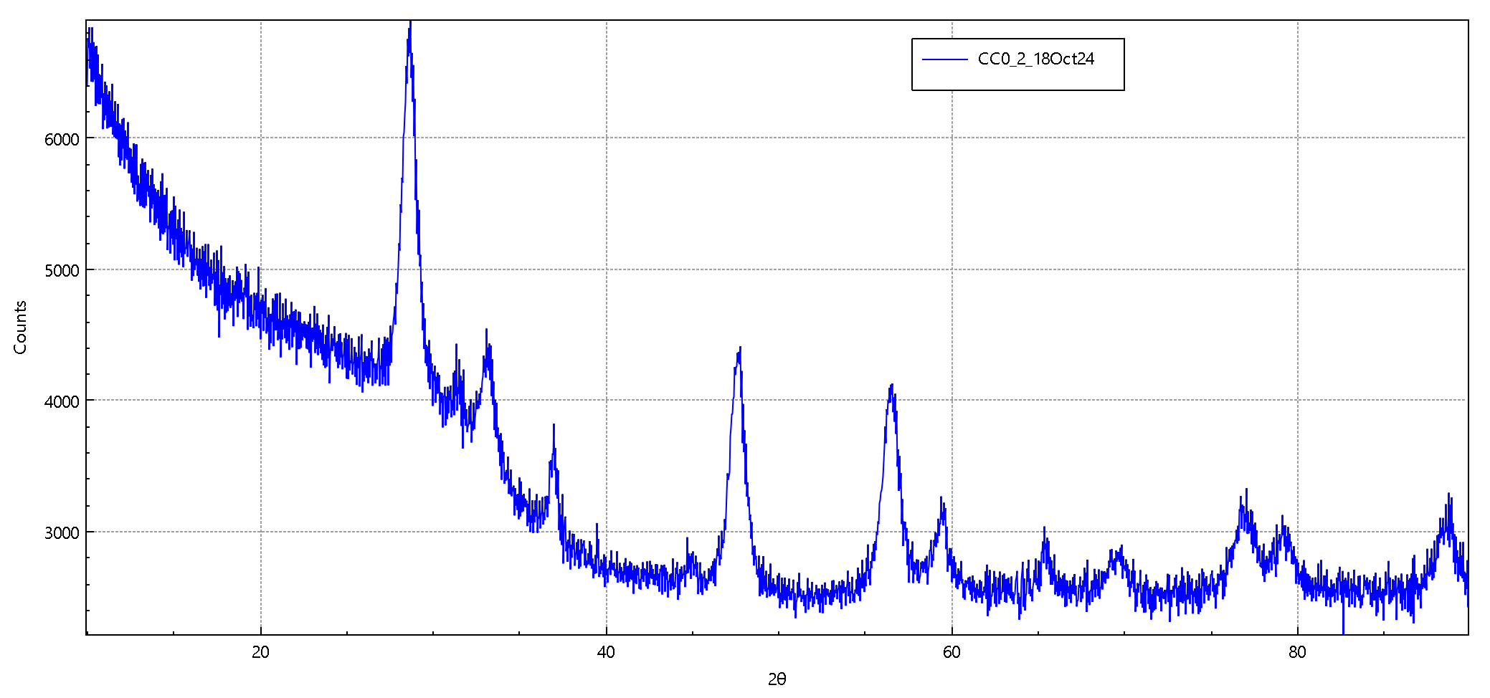
We were forming Ce₂Co₂0₅ again which was annealed for 6 hours at 500⁰C below it is an xrd pattern showing single phase peaks

Slide 7
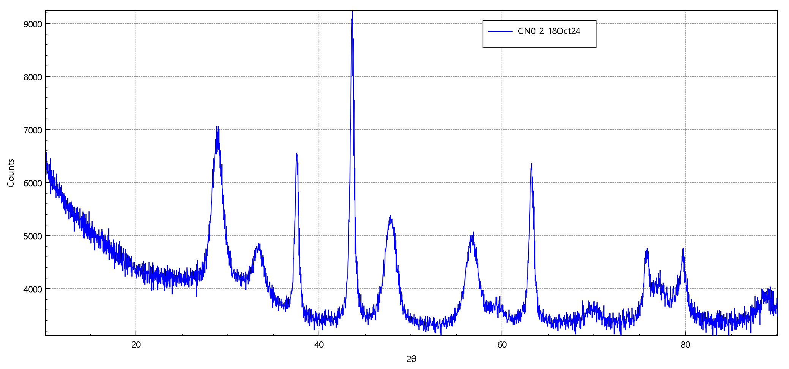
We were forming CeNi₃0₇ which was annealed for 6 hours at 500⁰C below it is an xrd pattern showing single phase peaks

Slide 8
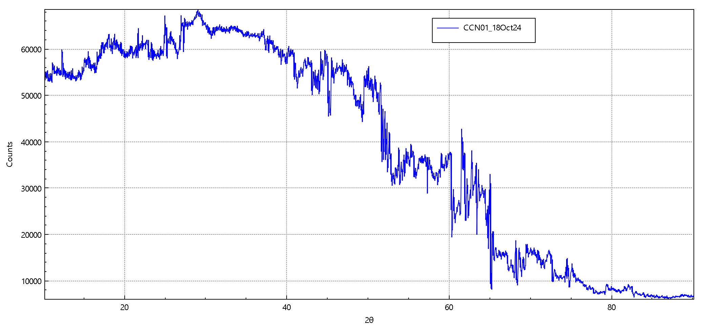
We were forming Ce(Co₂Ni)0₇ which was annealed for 6 hours at 500⁰C below it is an xrd pattern showing single phase peaks

